Slide 1






Adult Syndromic Surveillance
A hospital-based surveillance study nested within the adult medical wards of the Clinical Information Network (CIN).
March 2023 to May 2023 Overall Report.

Slide 2
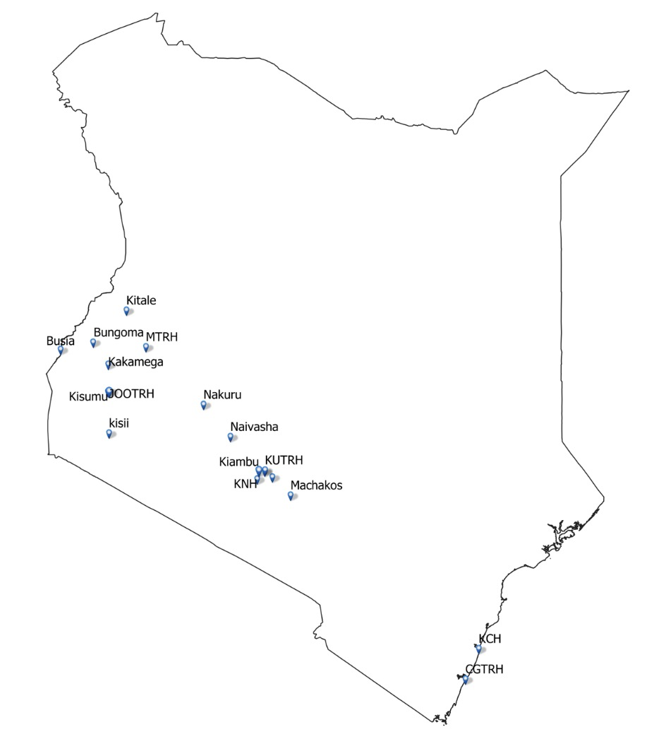
Background
The Clinical Information Network (CIN) is a technical collaboration between KWTRP, Ministry of Health (MOH), Kenya Paediatric Association, and partner hospitals across the country.
The hospital-based surveillance(SARI), nested within CIN, was set up as part of the national response to COVID-19 in Kenya.
It began in May 2020 at 16 hospitals across Kenya and has since contributed useful information to the MOH to allow for monitoring, planning and mobilising resources for the management and control of the spread of COVID-19
There is a push to increase surveillance for emerging and re-emerging/notifiable infections/diseases through syndromic surveillance as part of the national pandemic preparedness plan
Leveraging existing systems, the SARI surveillance was transitioned to a Syndromic surveillance in November 2022
Notes:
CIN was established in 2013 to support and improve strategies for clinical documentation, audit, and health service evaluation.
In April 2020, the Ministry of Health (MOH) through the office of the Director-General requested KWTRP to provide support to the Public Health Emergency Operations Centre (PHEOC) for national hospital-based sentinel surveillance for acute respiratory illness.

Slide 3
Milestones

Slide 4
Syndromic Surveillance Reports
Clinical data on all adults admitted to the medical wards of partner sites are collected daily and abstracted onto a standard online data collection tool
Reports are prepared and shared with partner sites monthly. They cover:
Participant demographic characteristics, clinical diagnosis and outcome
Summaries of key priority measures such as HIV status, COVID-19 testing and COVID-19 vaccination status
Documentation completeness
Recommendations to improve clinical documentation are shared with partner sites
Additional data requested by partner sites are shared in individual site reports as requested

Slide 5
Syndromic Surveillance Reports
The hospitals have been aggregated into groups based on their respective geographical locations in Kenya for ease of reporting.
The groups include:
Western region : Busia County Referral Hospital, Kisii County Teaching& Referral Hospital, Kisumu County Hospital, Kitale County Referral Hospital, Kakamega County General Teaching & Referral Hospital, Jaramogi Oginga Odinga Teaching & Referral Hospital and Bungoma County Referral Hospital.
Central region : Kiambu County Referral Hospital ,Mama Lucy Kibaki Hospital, Machakos Level 5 Hospital, Mbagathi County Hospital and Naivasha County Referral Hospital.
Coastal region : Coast General Teaching and Referral Hospital & Kilifi County Referral Hospital.

Slide 6
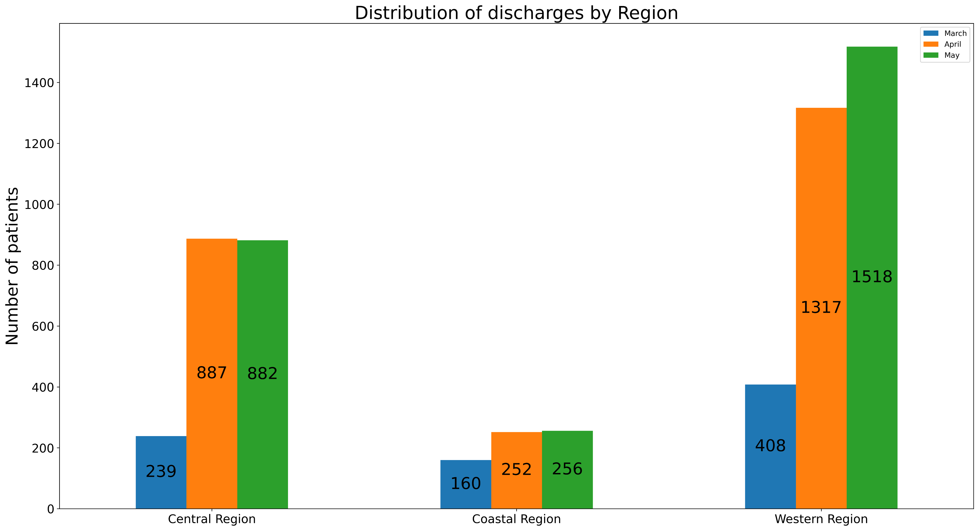
1. Discharge Trends by Regions
This figure summarises the patients discharged (dead, referred or alive) by each region in the months of March, April and May 2023.
Discharges, rather than admissions, are considered as they are easy to validate with daily bed returns and allow for outcome recording.
The total number of discharges in March was 807, in April was 2456 and in May 2023 was 2656.

Slide 7
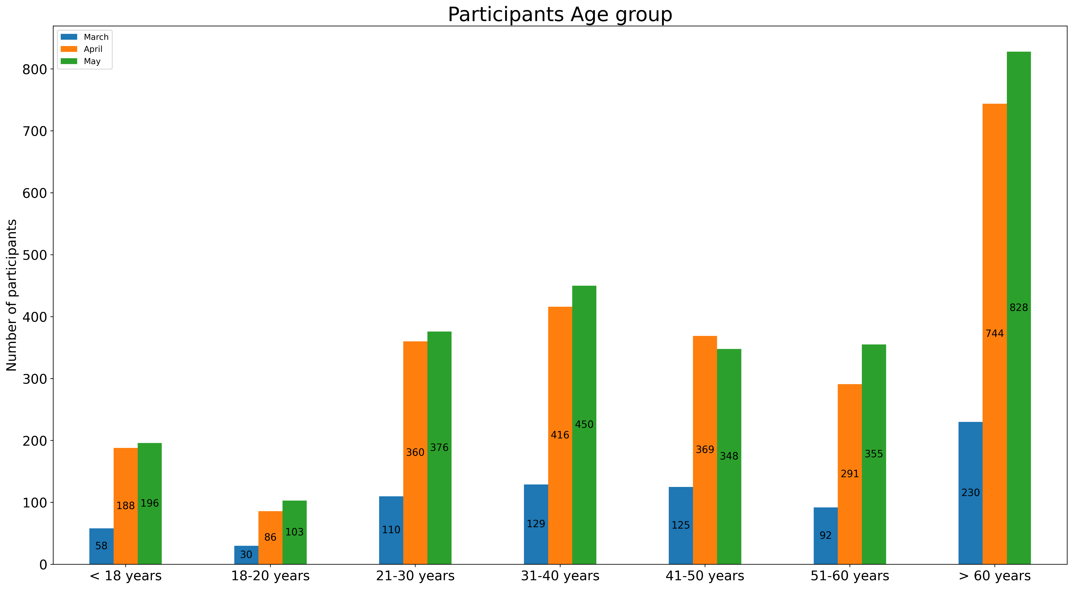
2. Distribution of Patients by Age
This figure summarizes the distribution of patients discharged in the months of March, April and May 2023 by age in all the regions.
Majority of the discharged patients were above 60 years of age across all the three months.
In some partner hospitals, paediatric patients above certain ages are admitted to the adult medical wards.
Out of all patients discharged from the adult medical wards in the three months period, 442 were aged below 18 years.
The lowest age of patients discharged from the adult medical wards was 13 years.

Slide 8
3. Distribution of patients by Gender
This figure shows the distribution of discharged patients by gender in the three months period in all the regions.
Slightly more males than females were discharged.

Slide 9
4. Priority Indicator – COVID-19 Vaccination Status
This table summarizes the COVID-19 vaccination status for all patients discharged in the months of March, April and May 2023 across all the regions.
An indeterminate entry refers to patients who were reported to have been vaccinated but the attending clinician was not able to verify the vaccination status through SMS or M-chanjo portal.
Majority of the discharged patients in the three months period had undocumented vaccination status.
Less than 5% of all the patients had verified vaccination status in the three months period.
COVID-19 Vaccination Status | March (n) (%) | April (n) (%) | May (n) (%)
Indeterminate | 42 (5%) | 1 (0%) | 3 (0%)
No | 264 (33%) | 258 (11%) | 165 (6%)
Undocumented | 475 (59%) | 2125 (87%) | 2443 (92%)
Yes | 26 (3%) | 72 (3%) | 45 (2%)
Total | 807 (100%) | 2456 (100%) | 2656 (100%)

Slide 10
4. Priority Indicator – HIV Status
This table summarizes the HIV status of patients discharged in the months of March, April and May 2023 in all the regions as recorded in their clinical notes for the current admission.
Recording of HIV status of all patients admitted to medical wards is a priority indicator for the Ministry of Health. Patients with an unknown HIV status should be offered free counselling and testing at contact with health services.
The HIV status of majority of the patients was undocumented ( was not recorded in the clinical notes) in all the three months.
HIV Status | March (n) (%) | April (n) (%) | May (n) (%)
Negative | 89 (11%) | 277 (11%) | 172 (6%)
Positive | 89 (11%) | 329 (13%) | 313 (12%)
Undocumented | 316 (39%) | 1538 (63%) | 1801 (68%)
Unknown | 313 (39%) | 312 (13%) | 370 (14%)
Total | 807 (100%) | 2456 (100%) | 2656 (100%)

Slide 11
5. Priority Indicator – Comorbidity at Admission
This table summarizes the proportion of patients recorded to have a comorbidity at admission in March, April and May 2023 in all the regions.
The proportion of admitted patients without any comorbidity was higher than those with comorbidities in all the three months.
Comorbidity at Admission | March (n) (%) | April (n) (%) | May (n) (%)
No | 415 (51%) | 1127 (46%) | 1249 (47%)
Undocumented | 79 (10%) | 393 (16%) | 368 (14%)
Yes | 313 (39%) | 936 (38%) | 1039 (39%)
Total | 807 (100%) | 2456 (100%) | 2656 (100%)

Slide 12
6. Duration of Hospital Stay
 | March |  | April |  | May
Study Region | Median Duration of hospital stay | Interquartile Range | Median Duration of hospital stay | Interquartile Range | Median Duration of hospital stay | Interquartile Range
Central Region | 6 days | 4 - 11 days | 6 days | 3 - 11 days | 7 days | 3 - 11 days
Coastal Region | 4 days | 1 - 8 days | 4 days | 1 - 9 days | 6 days | 3 - 11 days
Western Region | 5 days | 3 - 9 days | 4 days | 2 - 8 days | 4 days | 2 - 8 days
This table summarizes the average time spent by patients in the hospitals for the months of March, April and May 2023 in all the regions .ie. from point of admission to discharge.

Slide 13
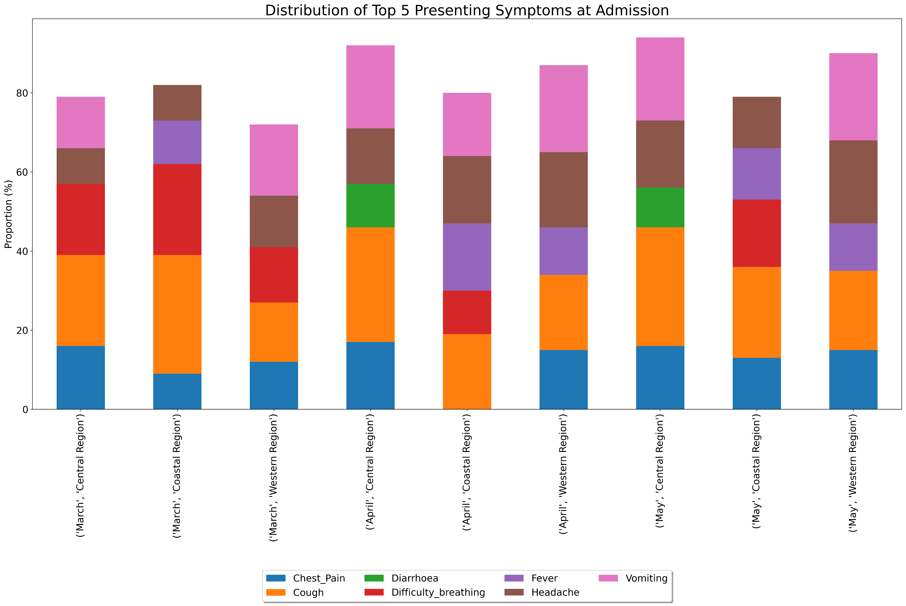
7. Presenting Symptoms at Admission
This figure represents the distribution of top 5 prevalent presenting symptoms of the disease(s) leading to hospitalization which were captured by the attending clinicians at admission in each of the regions in March, April and May 2023.

Slide 14
8. Completion of Demographic Measures
 | March |  |  |  | April |  |  |  | May
Study Region | Weight | Height | Sex | Age | Weight | Height | Sex | Age | Weight | Height | Sex | Age
Central Region | (239) 3% | (239) 3% | (239) 99% | (239) 98% | (887) 11% | (887) 11% | (887) 100% | (887) 100% | (882) 15% | (882) 14% | (882) 100% | (882) 100%
Coastal Region | (160) 51% | (160) 51% | (160) 100% | (160) 100% | (408) 42% | (408) 24% | (408) 62% | (408) 62% | (422) 41% | (422) 19% | (422) 61% | (422) 61%
Western Region | (408) 60% | (408) 62% | (408) 100% | (408) 93% | (1317) 19% | (1317) 18% | (1317) 100% | (1317) 100% | (1518) 20% | (1518) 20% | (1518) 100% | (1518) 100%
This table summarizes the documentation rate of demographic measures in the medical notes on the date of patient admission.
Weight and height were poorly documented across all the regions in the three months period.

Slide 15
9. Recording of Vital Signs
 | March |  |  |  |  | April |  |  |  |  | May
Study Region | Temp. | Resp. rate | Heart rate | SO2 | BP | Temp. | Resp. rate | Heart rate | SO2 | BP | Temp. | Resp. rate | Heart rate | SO2 | BP
Central Region | (239) 18% | (239) 52% | (239) 94% | (239) 94% | (239) 99% | (887) 15% | (887) 22% | (887) 91% | (887) 64% | (887) 93% | (882) 13% | (882) 23% | (882) 87% | (882) 64% | (882) 89%
Coastal Region | (160) 88% | (160) 89% | (160) 16% | (160) 99% | (160) 99% | (408) 42% | (408) 43% | (408) 21% | (408) 58% | (408) 59% | (422) 40% | (422) 42% | (422) 18% | (422) 55% | (422) 57%
Western Region | (408) 87% | (408) 77% | (408) 91% | (408) 87% | (408) 95% | (1317) 45% | (1317) 25% | (1317) 81% | (1317) 51% | (1317) 84% | (1518) 36% | (1518) 26% | (1518) 85% | (1518) 47% | (1518) 84%
Key = Temp : Temperature , Resp. rate : respiratory rate, SO2 : Oxygen saturation rate, BP: Blood pressure
This table summarizes the documentation rate of vital signs on the date of patient admission in each of the regions in the months of March, April and May 2023.

Slide 16
10. Recording of Key Priority Measures
 | March |  |  |  |  | April |  |  |  |  | May
Study Region | HIV status | COVID vac. | COVID tests | Com. | HIV status | COVID vac. | COVID tests | Com. | HIV status | COVID vac. | COVID tests | Com.
Central Region | (239) 48% | (239) 28% | (239) 75% | (239) 91% | (887) 40% | (887) 20% | (887) 1% | (887) 93% | (882) 29% | (882) 7% | (882) 0% | (882) 95%
Coastal Region | (160) 24% | (160) 40% | (160) 17% | (160) 98% | (408) 24% | (408) 26% | (408) 4% | (408) 59% | (422) 22% | (422) 26% | (422) 0% | (422) 55%
Western Region | (408) 83% | (408) 50% | (408) 83% | (408) 87% | (1317) 35% | (1317) 4% | (1317) 1% | (1317) 76% | (1518) 34% | (1518) 3% | (1518) 0% | (1518) 80%
Key = COVID vac : COVID 19 vaccination status, Com. : Comorbidity status.
This table summarizes the documentation rate of key priority measures in each of the regions for the months of March, April and May 2023.

Slide 17
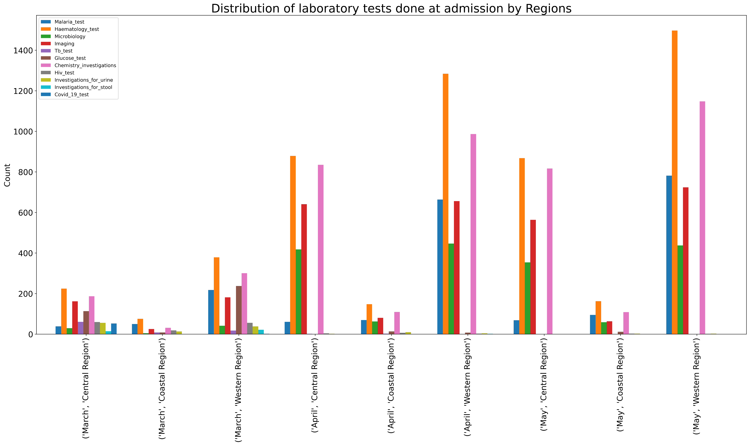
11. Laboratory Tests at Admission
This figure shows the absolute count of laboratory tests done at admission by hospitals in each region in March, April and May 2023.
Haematology test was the most frequently performed test in all the regions.

Slide 18
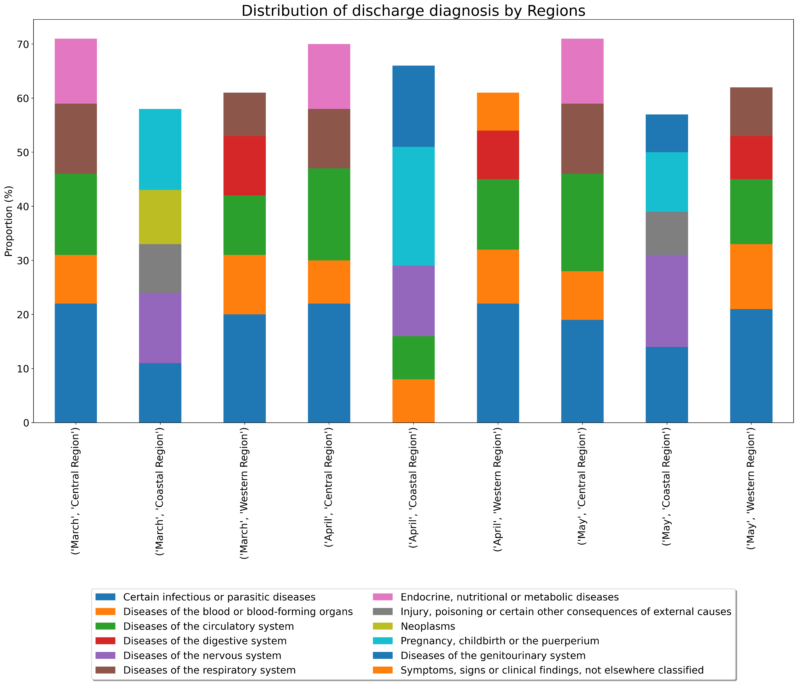
12. Disease patterns at Discharge
This figure shows the distribution of diseases at discharge in the months of March, April and May 2023 in each of the regions.
The diseases were grouped based on International Classification of Diseases 11th Revision (ICD-11).
The 5 most prevalent disease groups are shown for each region by month.

Slide 19
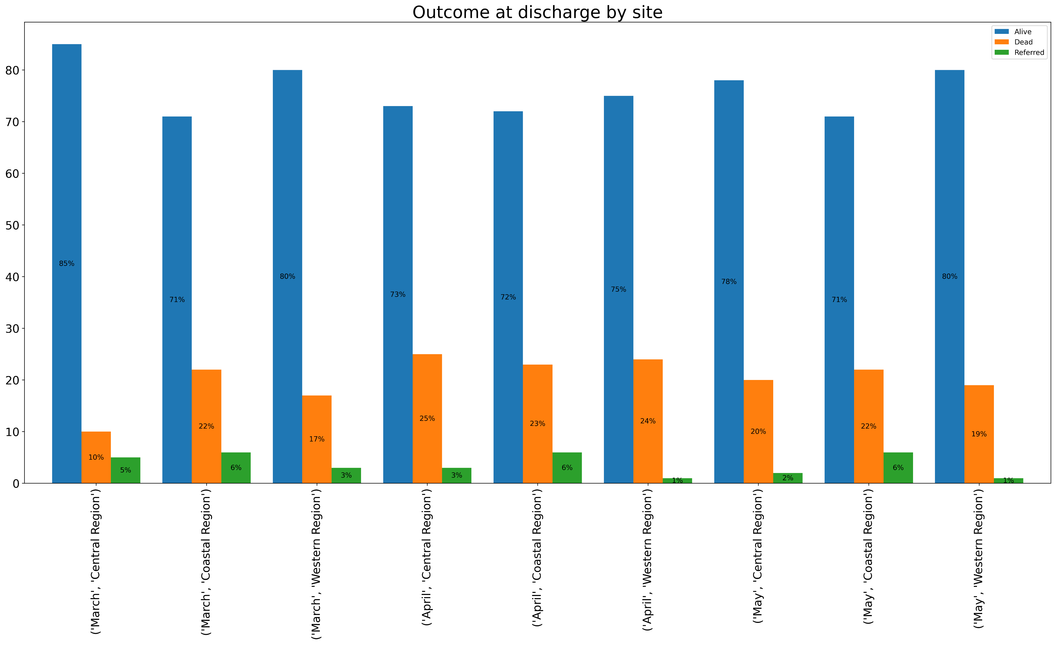
13. Outcome at Discharge
This figure shows the distribution of outcome at discharge in the months of March, April and May 2023 in each of the regions.
It indicates whether the admitted patients were discharged alive, referred or died.

Slide 20


Acknowledgements:
Funders (FCDO, BMGF)
Partners at MOH and County Governments
Clinical teams at the partner sites
Clinical Information Network (CIN)
Admin team at EDD in Kilifi and HSU in Nairobi
Study investigators and collaborators

